Slide 1
Permutations (Perm) and combinations (comb) – part 2
www.samuelchukwuemeka.com
Instructor: Samuel Chukwuemeka B.Eng., A.A.T, M.Ed., M.S “The Joy of a Teacher is the Success of his Students.” - SC
Notes:
www.samuelchukwuemeka.com

Slide 2
Objectives
Students will
Determine the number of permutations of items
Determine the number of permutations of duplicate items.
Determine the number of permutations of the total items taking some items at a item.
Determine the number of combinations of the total items taking some items at a time.
Pre-requisite Videos
Notes:
www.samuelchukwuemeka.com

Slide 3
Question 1
In how many ways can seven people line up at Register 3 in Walmart to check out?
This is a case of Permutation.
This is also a case of Fundamental Counting Principle
Solution
Number of ways = 7! = 5040 ways.
Notes:
www.samuelchukwuemeka.com

Slide 4
Question 2
Find the number of permutations of the word, “SAMUEL”
This is a case of Permutation
Solution
Number of ways = 6! = 720 ways.
Notes:
www.samuelchukwuemeka.com

Slide 5
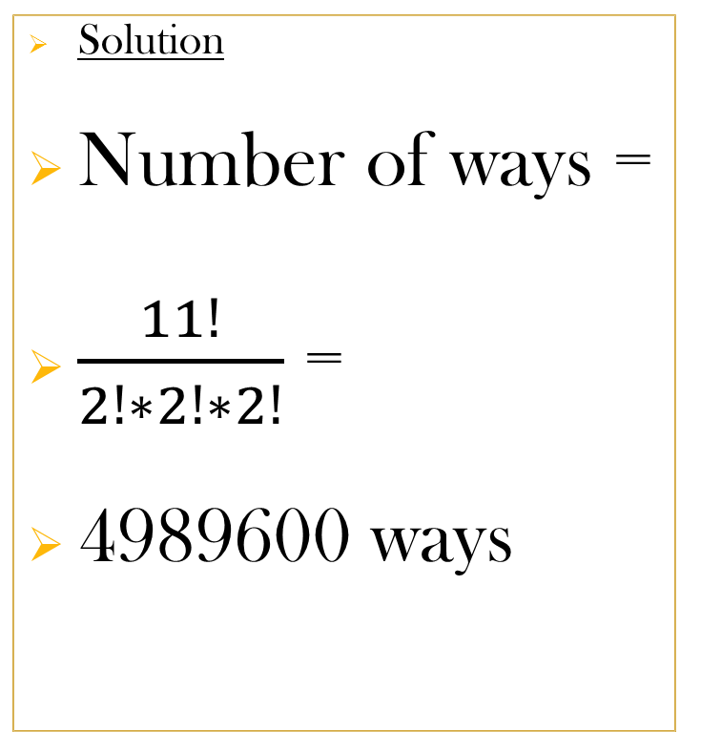
Question 3
Find the number of permutations of the word, “CHUKWUEMEKA”
This is a case of Permutation of Duplicates or Permutation of Indistinguishable Items or Permutation with Repetition.
Solution
Number of ways =
$\frac{11!}{2!∗2!∗2!}$ =
4989600 ways
Notes:
www.samuelchukwuemeka.com

Slide 6
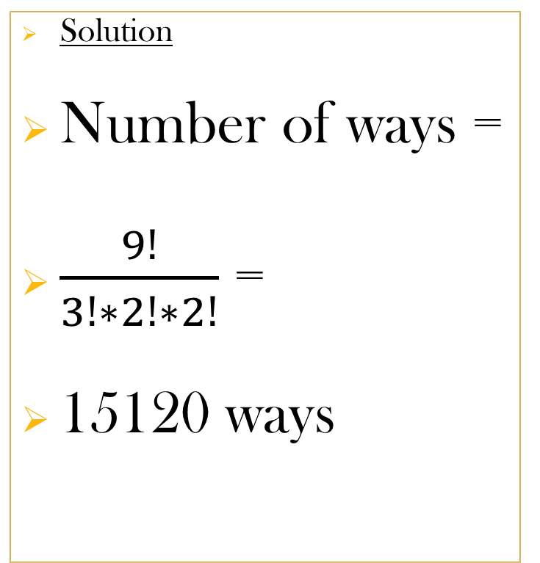
Question 4
In how many ways can the digits in the number 345237573 be arranged?
This is a case of Permutation of Duplicates.
Solution
Number of ways =
$\frac{9!}{3!∗2!∗2!}$ =
15120 ways
Notes:
www.samuelchukwuemeka.com

Slide 7
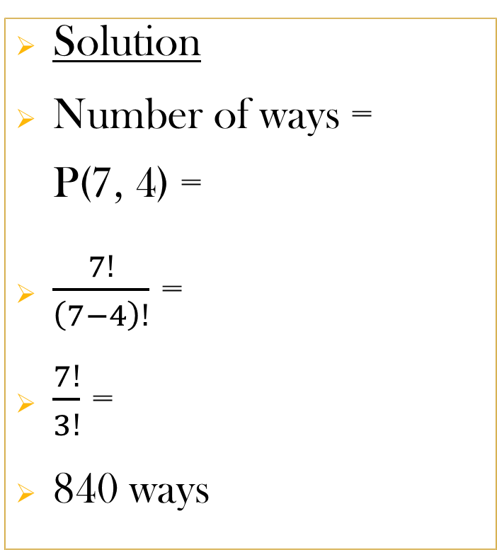
Question 5
In how many ways can four people boarding a bus be seated if the bus has seven vacant seats?
This is a case of Permutation
Solution
Number of ways = P(7, 4) =
$\frac{7!}{\left(7−4\right)!}$ =
$\frac{7!}{3!}$ =
840 ways
Notes:
www.samuelchukwuemeka.com

Slide 8
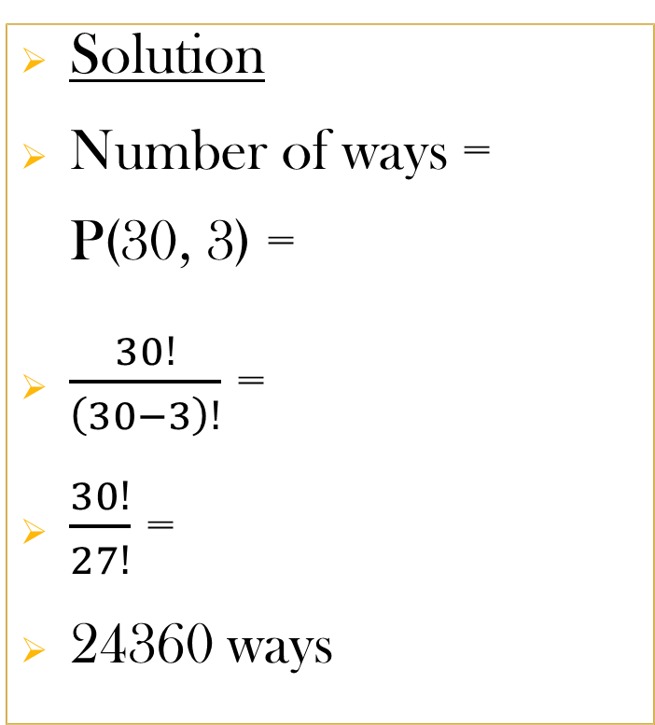
Question 6
Thirty people purchase raffle tickets. Three winning tickets are selected at random. In how many different ways can the prizes be awarded if the first prize is $5000, the second prize is $3000, and the third prize is $1000?
This is a case of Permutation
Solution
Number of ways = P(30, 3) =
$\frac{30!}{\left(30−3\right)!}$ =
$\frac{30!}{27!}$ =
24360 ways
Notes:
www.samuelchukwuemeka.com

Slide 9
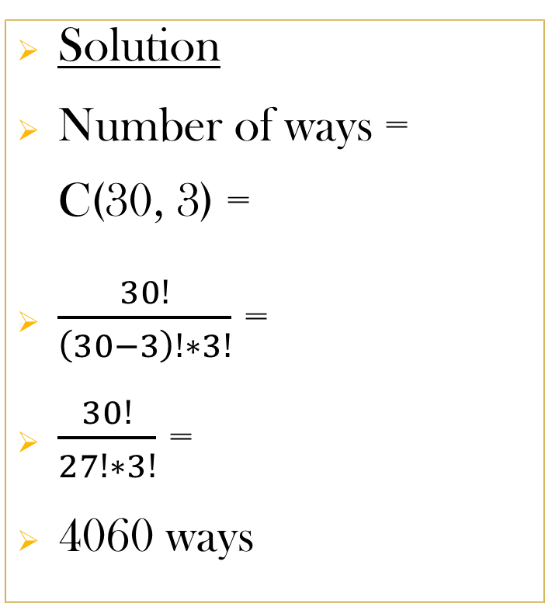
Question 7
Thirty people purchase raffle tickets. Three winning tickets are selected at random. In how many different ways can the prizes be awarded if each prize is $1000?
This is a case of Combination
Solution
Number of ways = C(30, 3) =
$\frac{30!}{\left(30−3\right)!∗3!}$ =
$\frac{30!}{27!∗3!}$ =
4060 ways
Notes:
www.samuelchukwuemeka.com

Slide 10
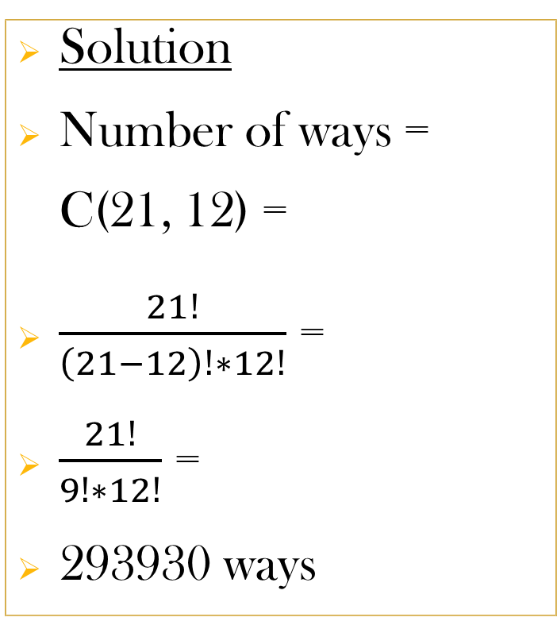
Question 8
In how many different ways can a committee of 12 be chosen from a group of 21 politicians ?
This is a case of Combination
Solution
Number of ways = C(21, 12) =
$\frac{21!}{\left(21−12\right)!∗12!}$ =
$\frac{21!}{9!∗12!}$ =
293930 ways
Notes:
www.samuelchukwuemeka.com

Slide 11
Question 9
In how many different ways can a committee of 12 be chosen from a group of 16 Republicans and 5 Democrats?
This is a case of Combination
Solution
Number of ways = C(21, 12) =
$\frac{21!}{\left(21−12\right)!∗12!}$ =
$\frac{21!}{9!∗12!}$ =
293930 ways
Notes:
www.samuelchukwuemeka.com

Slide 12
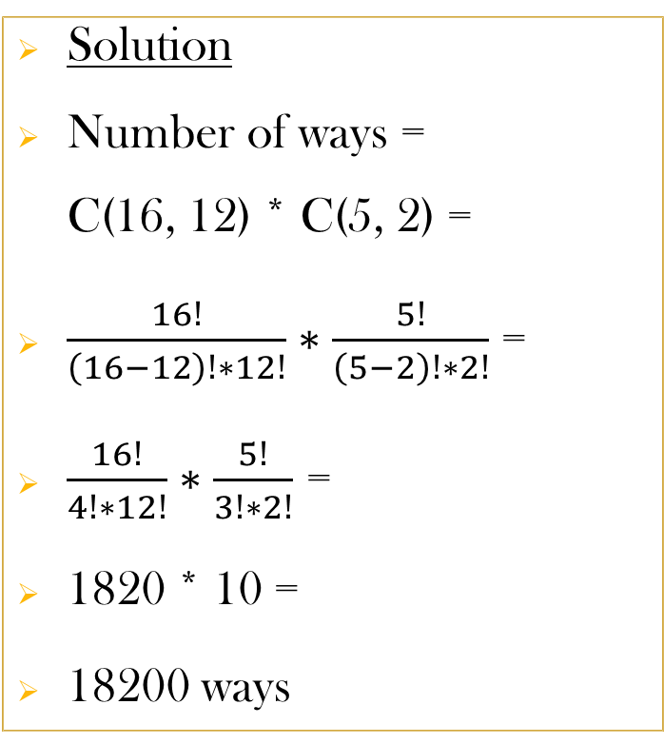
Question 10
In how many different ways can a committee of 12 Republicans and 2 Democrats be chosen from a group of 16 Republicans and 5 Democrats?
This is a case of Combination
Solution
Number of ways = C(16, 12) * C(5, 2) =
$\frac{16!}{\left(16−12\right)!∗12!}∗\frac{5!}{\left(5−2\right)!∗2!}$ =
$\frac{16!}{4!∗12!}∗\frac{5!}{3!∗2!}$ =
1820 * 10 =
18200 ways
Notes:
www.samuelchukwuemeka.com

Slide 13
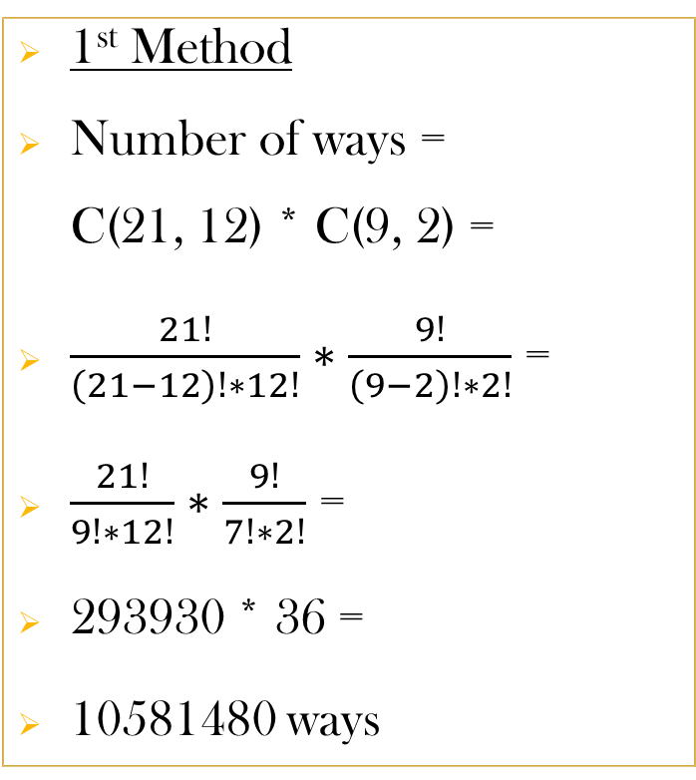
Question 11
In how many different ways can a committee of 12 Republicans and 2 Democrats be chosen from a group of 21 prospective candidates?
This is a case of Combination
1st Method
Number of ways = C(21, 12) * C(9, 2) =
$\frac{21!}{\left(21−12\right)!∗12!}∗\frac{9!}{\left(9−2\right)!∗2!}$ =
$\frac{21!}{9!∗12!}∗\frac{9!}{7!∗2!}$ =
293930 * 36 =
10581480 ways
Notes:
www.samuelchukwuemeka.com

Slide 14

Question 11 (2nd Method)
In how many different ways can a committee of 12 Republicans and 2 Democrats be chosen from a group of 21 prospective candidates?
This is a case of Combination
2nd Method
Number of ways = C(21, 2) * C(19, 12) =
$\frac{21!}{\left(21−2\right)!∗2!}∗\frac{19!}{\left(19−12\right)!∗12!}$ =
$\frac{21!}{19!∗2!}∗\frac{19!}{7!∗12!}$ =
210 * 50388 =
10581480 ways
Notes:
www.samuelchukwuemeka.com

Slide 15
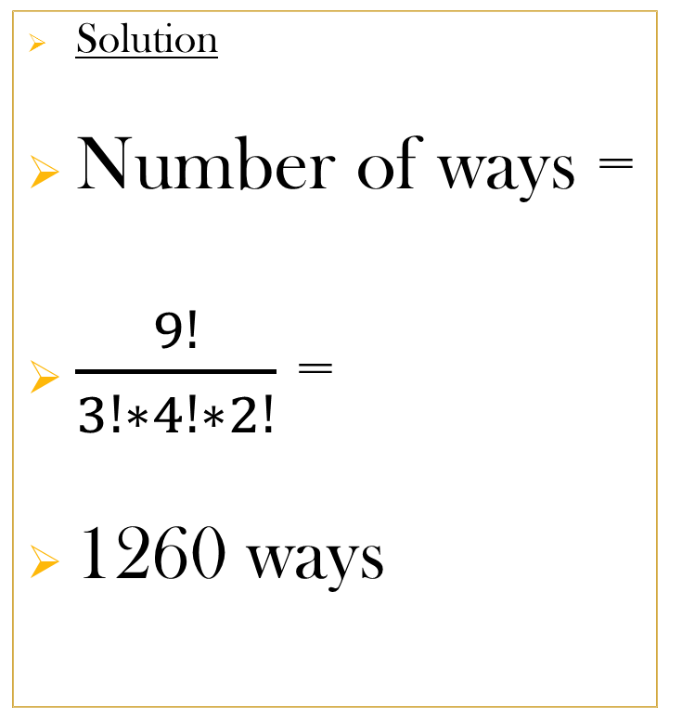
Question 12
How many different signals can be made by hoisting three yellow flags, four green flags, and two red flags on a ship’s mast at the same time?
This is a case of Permutation of Duplicates
Solution
Number of ways =
$\frac{9!}{3!∗4!∗2!}$ =
1260 ways
Notes:
www.samuelchukwuemeka.com

Slide 16

Question 13
Gold Star Realty received 12 inquiries from prospective home buyers. In how many ways can the inquiries be directed to any three of the firm’s real estate agents if each agent handles four inquiries?
This is a case of Permutation of Duplicates
Solution
Number of ways =
$\frac{12!}{4!∗4!∗4!}$ =
34650 ways
Notes:
www.samuelchukwuemeka.com

Slide 17

Question 14
Samdom City employs 15 police officers: 7 of which patrol in cars; 6 of which patrol in bikes; and 2 of which do station duties. How many different job configurations are there?
This is a case of Permutation of Duplicates
Solution
Number of ways =
$\frac{15!}{7!∗6!∗2!}$ =
180180 ways
Notes:
www.samuelchukwuemeka.com

Slide 18

Question 15
Mr. C usually gives 20 questions covering all the sections of a topic. His students must answer only 10 correctly which includes a minimum number of questions from each section. Assume they must answer only 2 questions from 5 questions in each section asked; how many ways can they answer the 10 questions?
This is a case of Combination
Solution
Number of ways = C(5, 2) * C(15, 8) =
$\frac{5!}{\left(5−2\right)!∗2!}∗\frac{15!}{\left(15−8\right)!∗8!}$ =
$\frac{5!}{3!∗2!}∗\frac{15!}{7!∗8!}$ =
10 * 6435 =
64350 ways
Notes:
www.samuelchukwuemeka.com

Slide 19
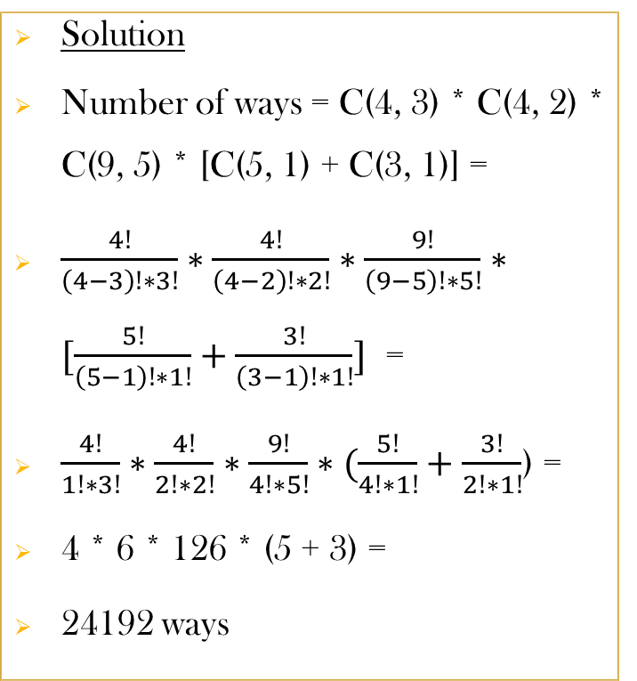
Question 16
A CIS major must select 3 of 4 mathematics courses, 2 of 4 business courses, 5 of 9 elective courses, and either 1 of 5 history courses or 1 of 3 social science courses. How many different curricula are available for the student?
This is a case of Combination
Solution
Number of ways = C(4, 3) * C(4, 2) * C(9, 5) * [C(5, 1) + C(3, 1)] =
$\frac{4!}{\left(4−3\right)!∗3!}∗\frac{4!}{\left(4−2\right)!∗2!}∗\frac{9!}{\left(9−5\right)!∗5!}∗[\frac{5!}{\left(5−1\right)!∗1!}+\frac{3!}{\left(3−1\right)!∗1!}]$ =
$\frac{4!}{1!∗3!}∗\frac{4!}{2!∗2!}∗\frac{9!}{4!∗5!}∗(\frac{5!}{4!∗1!}+\frac{3!}{2!∗1!}$) =
4 * 6 * 126 * (5 + 3) =
24192 ways
Notes:
www.samuelchukwuemeka.com

Slide 20
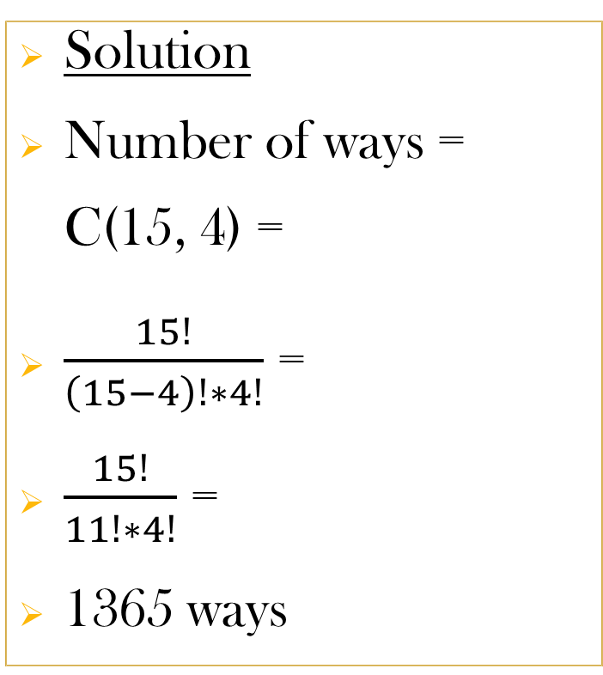
Question 17
15 applicants applied for 4 open jobs in a company. How many ways can the job be filled if no preference is given to any applicant?
This is a case of Combination
Solution
Number of ways = C(15, 4) =
$\frac{15!}{\left(15−4\right)!∗4!}$ =
$\frac{15!}{11!∗4!}$ =
1365 ways
Notes:
www.samuelchukwuemeka.com

Slide 21
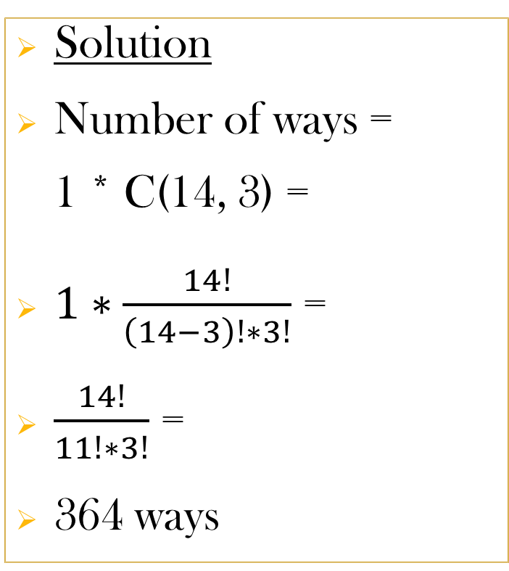
Question 18
15 applicants applied for 4 open jobs in a company. How many ways can the job be filled if 1 particular applicant must be given a job?
This is a case of Combination
Solution
Number of ways = 1 * C(14, 3) =
$1∗\frac{14!}{\left(14−3\right)!∗3!}$ =
$\frac{14!}{11!∗3!}$ =
364 ways
Notes:
www.samuelchukwuemeka.com

Slide 22
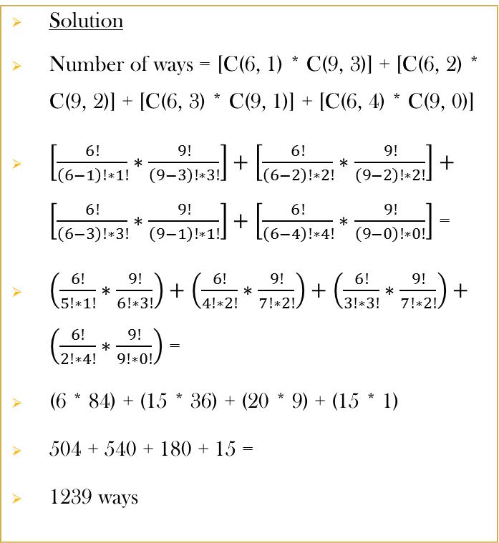
Question 19
15 applicants applied for 4 open jobs in a company. How many ways can the job be filled if the group of applicants includes 9 men and 6 women and at least 1 woman must be given a job ?
This is a case of Combination
Solution
Number of ways = [C(6, 1) * C(9, 3)] + [C(6, 2) * C(9, 2)] + [C(6, 3) * C(9, 1)] + [C(6, 4) * C(9, 0)]
$\left[\frac{6!}{\left(6−1\right)!∗1!}∗\frac{9!}{\left(9−3\right)!∗3!}\right]+\left[\frac{6!}{\left(6−2\right)!∗2!}∗\frac{9!}{\left(9−2\right)!∗2!}\right]+\left[\frac{6!}{\left(6−3\right)!∗3!}∗\frac{9!}{\left(9−1\right)!∗1!}\right]+\left[\frac{6!}{\left(6−4\right)!∗4!}∗\frac{9!}{\left(9−0\right)!∗0!}\right]$ =
$\left(\frac{6!}{5!∗1!}∗\frac{9!}{6!∗3!}\right)+\left(\frac{6!}{4!∗2!}∗\frac{9!}{7!∗2!}\right)+\left(\frac{6!}{3!∗3!}∗\frac{9!}{7!∗2!}\right)+\left(\frac{6!}{2!∗4!}∗\frac{9!}{9!∗0!}\right)$ =
(6 * 84) + (15 * 36) + (20 * 9) + (15 * 1)
504 + 540 + 180 + 15 =
1239 ways
Notes:
www.samuelchukwuemeka.com

Slide 23
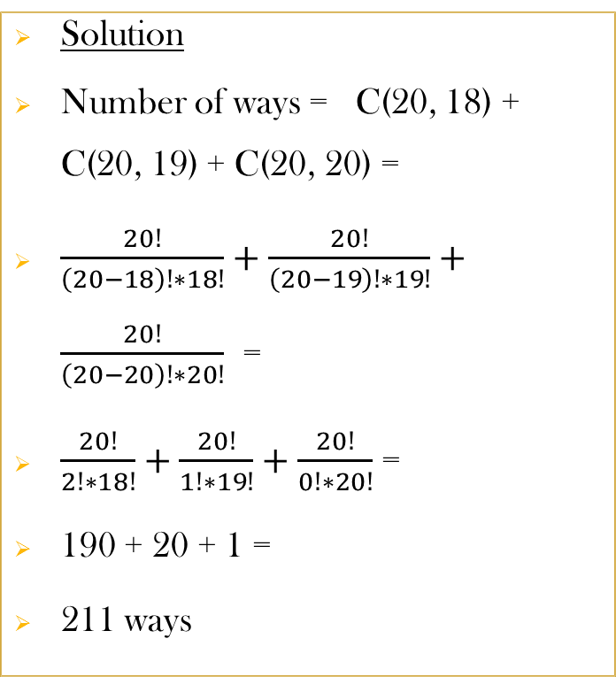
Question 20
A state Motor Vehicle Department requires learners to pass a written test. The test consists of 20 true-or-false questions. At least 18 must be answered correctly to qualify for a permit. In how ways can a learner qualify for a permit?
This is a case of Combination
Solution
Number of ways = C(20, 18) + C(20, 19) + C(20, 20) =
$\frac{20!}{\left(20−18\right)!∗18!}+\frac{20!}{\left(20−19\right)!∗19!}+\frac{20!}{\left(20−20\right)!∗20!}$ =
$\frac{20!}{2!∗18!}+\frac{20!}{1!∗19!}+\frac{20!}{0!∗20!}$ =
190 + 20 + 1 =
211 ways
Notes:
www.samuelchukwuemeka.com

Slide 24
References
Blitzer, R. (2015). Thinking Mathematically Plus New Mymathlab With Pearson Etext Access Card. Pearson College Div.
Tan, S. (2015). Finite mathematics for the managerial, life, and social sciences (11th ed.).

